Slide 1

Chapter 2 ~ Mathematical Tools in Digital Image Processing
Created By
Utsha Das
Lecturer, Dept. of CSE RUET, Rajshahi-6204, Bangladesh.
Modified by
Md. Manirujjaman
Lecturer, Dept. of CSE
DIU, Satarkul, Badda, Dhaka

Slide 2
Array versus Matrix Operation
Images can be viewed as array of pixels.
An array operation involves one or more images is carried out on a pixel by pixel basis.
Images can also be viewed equivalently as matrices.
There are many situations in which operations between images are carried out using matrix theory.

Slide 3
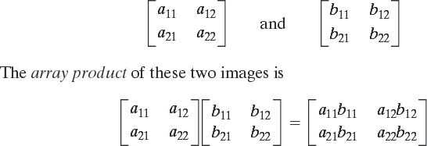
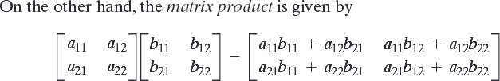
Array versus Matrix Operation
- For example, consider the following 2x2 images:

Slide 4
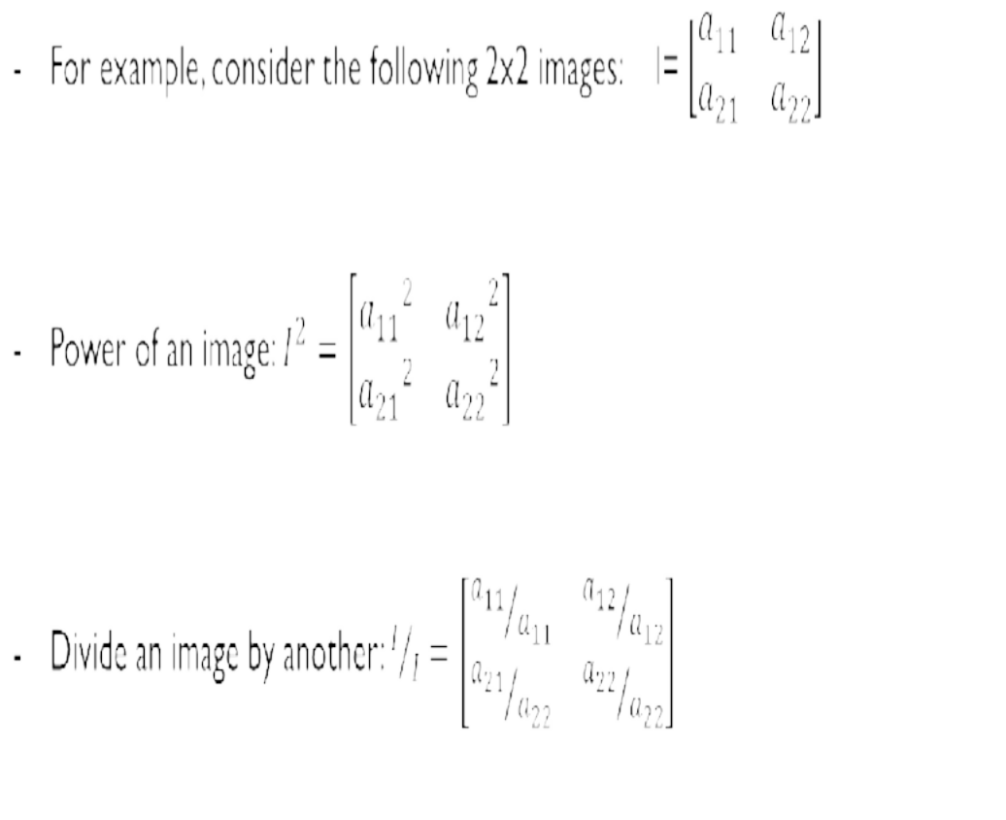
Array versus Matrix Operation
We assume array operations throughout the course:
For example,
When we refer to raising an image to a power, we mean that each individual pixel is raised to that power;
When we refer to dividing an image by another, we mean that the division is between corresponding pixel pairs, and so on.

Slide 5

Linear versus Nonlinear Operation
Consider a general operator, H, that produces an output image, g(x,y), for a given input image, f(x,y):
H is said to be a linear operator if,
Where, a_{i} and a_{j} are arbitrary constant and f_{i}(x, y) and f_{j}(x, y) are two images of same sizes.

Slide 6
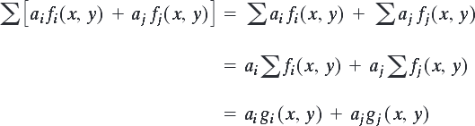
Linear versus Nonlinear Operation
Let’s consider the general operator ‘H’ as a summation operator ‘Σ’

Slide 7
Linear versus Nonlinear Operation
Given that, 𝑓₁ =
0 2
2 3
and 𝑓₂ =
6 5
4 7
where, 𝑎₁ = 1, 𝑎₂ = −1
Now, ∑[𝑎_{𝑖}𝑓_{𝑖}(𝑥, 𝑦) + 𝑎_{𝑗}𝑓_{𝑗}(𝑥, 𝑦)] = ∑ 1 ∗
0 2
2 3
+ −1 ∗
6 5
4 7
= ∑
0 2
2 3
+
−6 −5
−4 −7
= ∑
−6 −3
−2 −4
= −15
Again, ∑ 𝑎_{𝑖}𝑓_{𝑖}(𝑥, 𝑦) + ∑ 𝑎_{𝑗}𝑓_{𝑗}(𝑥, 𝑦)
= ∑ ⁰
2 _{+ ∑} −6 −5
−7
2 3 −4
=7 − 22
= −15

Slide 8
Linear versus Nonlinear Operation
Two Properties of Linear Operation:
Additivity: 𝐻 𝑓_{𝑖} 𝑥, 𝑦 + 𝑓_{𝑗} 𝑥, 𝑦 = 𝐻 𝑓_{𝑖} 𝑥, 𝑦
Homogeneity: 𝐻 𝑎_{𝑖}𝑓_{𝑖} 𝑥, 𝑦 = 𝑎_{𝑖}𝐻[𝑓_{𝑖} (𝑥, 𝑦)]
+ 𝐻 𝑓_{𝑗} 𝑥, 𝑦
Equation indicates that the output of a linear equation due to the sum of two inputs is the same as performing the operation on the inputs individually and then summing the results.
In addition, the output of a linear equation to a constant times an input as the same as the output of the
operation due to original input multiplied by that constant.

Slide 9
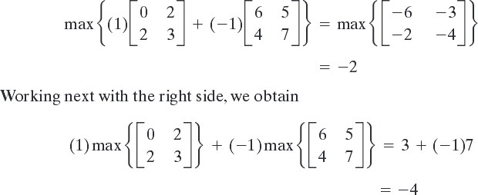
Linear versus Nonlinear Operation
Example: Non-Linear Operation
Consider the max operation, whose function is to find the maximum value of pixels in an image,
max [a_{i} f_{i}(x,y) + a_{j} f _{j}(x,y)] = max [a_{i} f_{i}(x,y)] + max [a_{j} f _{j}(x,y)]
= a_{i} max [f_{i}(x,y)] + a_{j} max [f _{j}(x,y)]
= a_{i} g_{i} ( x, y ) + a_{j} g _{j} ( x, y )

Slide 10
Linear versus Nonlinear Operation
Linear operation are exceptionally important, because they are based on a large body of theoretical and
practical results that are applicable to image processing.
Non-linear systems are not nearly as well understood, so there scope of application is more limited.
But, there are several non-linear image processing operations whose performance far exceeds what is
achievable by their linear counterparts.

Slide 11
Arithmetic Operations
Arithmetic operations between images are array operations which, a means that arithmetic operations are carried out between corresponding pixel pairs.
𝑠 𝑥, 𝑦 = 𝑓 𝑥, 𝑦 + 𝑔 𝑥, 𝑦
d 𝑥, 𝑦 = 𝑓 𝑥, 𝑦 − 𝑔 𝑥, 𝑦 p 𝑥, 𝑦 = 𝑓 𝑥, 𝑦 ∗ 𝑔 𝑥, 𝑦 v 𝑥, 𝑦 = 𝑓 𝑥, 𝑦 /𝑔 𝑥, 𝑦
It is understood that, the operations that are performed between corresponding pixel pairs in f and g for x=0, 1, 2……..M-1 and y=0, 1, 2…….N-1. Where, M and N are the rows and columns of the images. Clearly, s, d, p and v are the images of M X N also.

Slide 12
Arithmetic Operation
Few important considerations:-
If the result is a floating point number, round off it’s value.
If the result is above the pixel range, select the maximum range value.
If the result is below the pixel range, select the minimum range value.
If the result is infinity, write it as zero.

Slide 13
Arithmetic Operation
A
B A+B
A
B
A*B
0 | 100 | 10 |  | 10 | 100 | 5 |  | 10 | 200 | 15 |  | 0 | 100 | 10 |  | 10 | 100 | 5 |  | 0 | 255 | 50
4 | 0 | 10 | + | 2 | 0 | 0 | = | 6 | 0 | 10 |  | 4 | 0 | 10 | ∗ | 2 | 0 | 0 | = | 8 | 0 | 100
8 | 0 | 5 |  | 0 | 10 | 10 |  | 8 | 10 | 15 |  | 8 | 0 | 5 |  | 0 | 10 | 10 |  | 0 | 0 | 50
 | A |  |  |  | B |  |  | A-B |  |  |  | A |  |  |  | B |  |  | A/B
0 | 100 | 10 |  | 10 | 100 | 5 |  | 0 0 | 5 |  | 0 | 100 | 10 |  | 10 | 100 | 5 |  | 0 1 | 2
4 | 0 | 10 | − | 2 | 0 | 0 | = | 2 0 | 10 |  | 4 | 0 | 10 | / | 2 | 0 | 0 | = | 2 0 | 0
8 | 0 | 5 |  | 0 | 10 | 10 |  | 8 0 | 0 |  | 8 | 0 | 5 |  | 0 | 10 | 10 |  | 0 0 | 0
Here, all the considered images are of gray level and their intensity value ranges from 0…….255

Slide 14
Arithmetic Operation (Addition)
Example: Addition (averaging) of noisy images for noise reduction.
Used in image enhancement.
Image averaging is used in the field of astronomy.
Let g(x,y) denote a corrupted image formed by the addition of noise, η(x, y) to a noiseless image f(x,y); that is,
g( x, y ) = f ( x, y ) +η( x, y )
The objective of the following procedure is to reduce the noise content of the output image by adding a set of noisy input images, This is a technique used frequently for image enhancement.

Slide 15
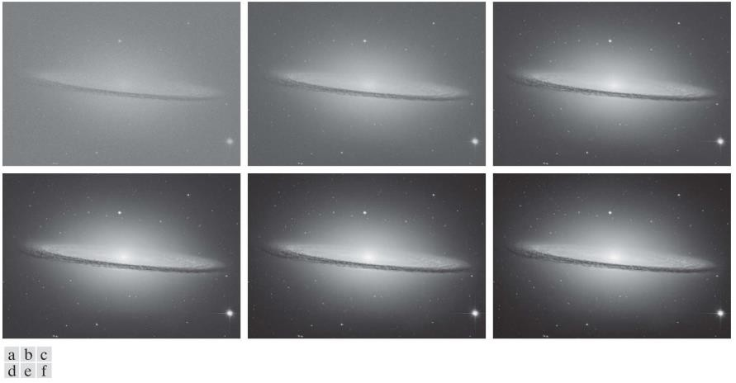
Arithmetic Operation (Addition)
Figure 1: (a) Sample noisy image of the Sombrero Galaxy. (b)-(f) Result of averaging 10, 50, 100, 500, and 1,000 noisy images, respectively. All images are of size pixels, and all were scaled so that their intensities would span the full [0, 255] intensity scale.

Slide 16
Arithmetic Operation (Subtraction)
A frequent application of image subtraction is in the enhancement of including correcting uneven illuminance and comparing two images.
Mask mode radiography in medical imaging.

Slide 17
Arithmetic Operation (Subtraction)
Image subtraction in medical imaging is called mask mode radiography
g( x, y ) = f ( x, y ) − h( x, y )
In this case h(x, y), the mask, is an X-ray image of a region of a patient’s body captured by an intensified TV camera
(instead of traditional X-ray film) located opposite an X-ray source.
The procedure consists of injecting an X-ray contrast material into the patient’s bloodstream, taking a series of
images called live images, f(x, y), samples of which are denoted as f(x, y)] of the same anatomical region as h(x, y),
and subtracting the mask from the series of incoming live images after injection of the contrast material.
The net effect of subtracting the mask from each sample live image is that the areas that are different between f(x, y) and h(x, y) appear in the output image, g(x, y), as enhanced detail.

Slide 18

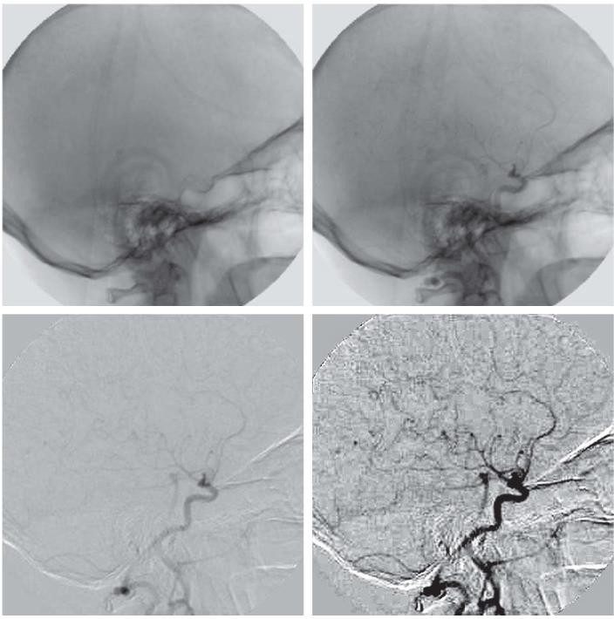
Arithmetic Operation (Subtraction)
Figure 3: Digital subtraction angiography. (a) Mask image. (b) A live image. (c) Difference between (b) and (a). (d) Enhanced difference image.

Slide 19
Arithmetic Operation (Multiplication and Division)
An important application of image multiplication (and division) is shading correction.
Suppose that an imaging sensor produces images, g(x,y),
g( x, y ) = f ( x, y )h( x, y )
-f(x,y) indicates perfect image
-h(x,y) indicates a shading function
Notes:
In digital image processing, shading refers to uneven brightness or intensity across an image that is not part of the actual scene.
It is usually caused by:
Non-uniform illumination (lighting is brighter in some areas and darker in others).
Sensor imperfections (camera or scanner may respond differently in different regions).
Lens or optical effects (vignetting in cameras).
If you take a photo of a white sheet of paper, ideally all pixels should have the same brightness.
But due to lighting or camera issues, some areas appear darker and some brighter.
This uneven brightness is called shading.

Slide 20
Arithmetic Operation (Multiplication and Division)
If h(x, y) is known!!!!
f ( x, y ) = g( x, y ) ÷ h( x, y )
- multiplying the sensed image g(x, y) by the inverse of h(x, y)

Slide 21
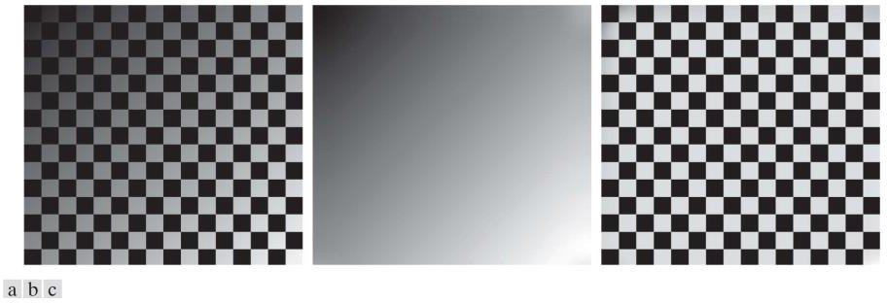
Arithmetic Operation (Multiplication and Division)
Figure 4: Shading correction. (a) Shaded test pattern. (b) Estimated shading pattern.
(c) Product of (a) by the reciprocal of (b).

Slide 22
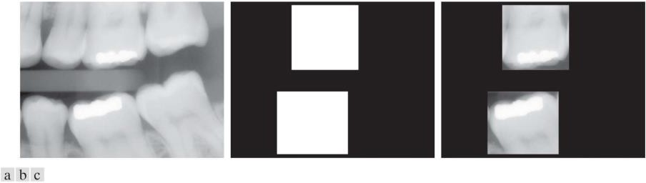
Arithmetic Operation (Multiplication and Division)
Another common use of image multiplication is in masking, also called region of interest (ROI), operations.
Multiplying a given image by a mask image that has 1’s in the ROI and 0’s elsewhere.
Figure 5: (a) Digital dental X-ray image. (b) ROI mask for isolating teeth with fillings (white corresponds to 1 and black corresponds to 0). (c)
Product of (a) and (b).

Slide 23
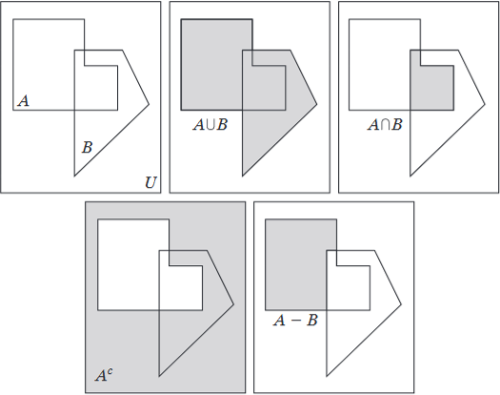
Set Operations

Slide 24
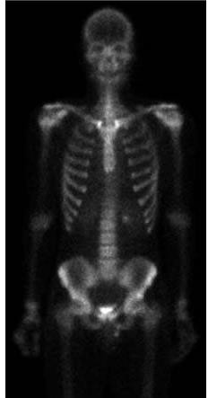
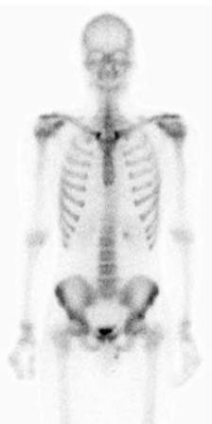
Image Negatives
Set operations involving image intensities.
Let the elements of a grayscale image be represented by a set A whose elements are triplets of the form (x, y, z), where
x and y are spatial coordinates, and z denotes intensity values. We define the complement of A as the set,
A^{c} = {( x, y,K − z ) |( x, y,z ) ∈ A }
K = 2^{k} − 1, k- numberof bits
A =
A^{c} =

Slide 25
Logical Operations
Logical operations deal with TRUE (typically denoted by 1) and FALSE (typically denoted by 0) variables and expressions.
When dealing with binary images, we can think of foreground (1-valued) and background (0-valued) sets of
pixels.
We work with set and logical operators on binary images using one of two basic approaches: (1) we can use the coordinates of individual regions of foreground pixels in a single image as sets, or (2) we can work with one or more images of the same size and perform logical operations between corresponding pixels in those arrays.
When dealing with binary images, it is common practice to refer to union, intersection, and complement as the OR, AND, and NOT logical operations, where “logical” arises from logic theory in which 1 and 0 denote true and false, respectively.

Slide 26
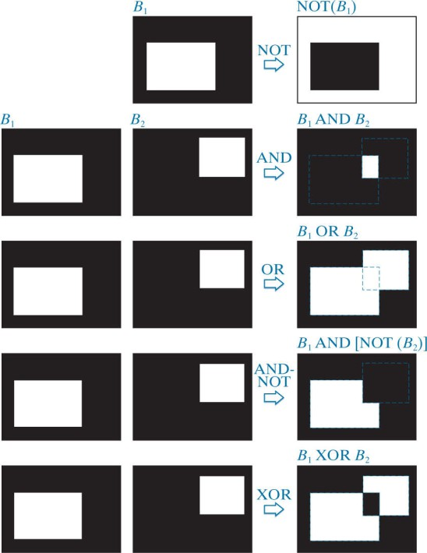
Logical Operations

Slide 27
Spatial Operations
Spatial operations are performed directly on the pixels of a given image.
Classifications of spatial operations:
Single pixel operations
Neighborhood operations
Geometric spatial transformations

Slide 28
Spatial Operations
Single Pixel Operations
-Alter the values of an image pixels based on intensity.
-Finding the negative of a given image.
-Example: NOT operation.
0 | 0 | 0 | 0
0 | 1 | 1 | 0
0 | 1 | 1 | 0
0 | 1 | 1 | 0
0 | 0 | 0 | 0
1 | 1 | 1 | 1
1 | 0 | 0 | 1
1 | 0 | 0 | 1
1 | 0 | 0 | 1
1 | 1 | 1 | 1

Slide 29
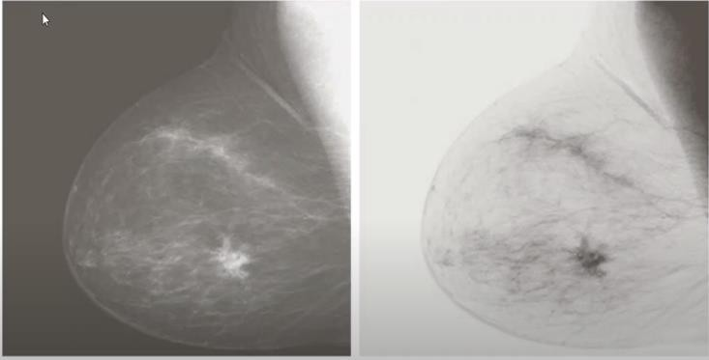
Spatial Operations
Single Pixel Operations
Figure 6: Image Negatives

Slide 30
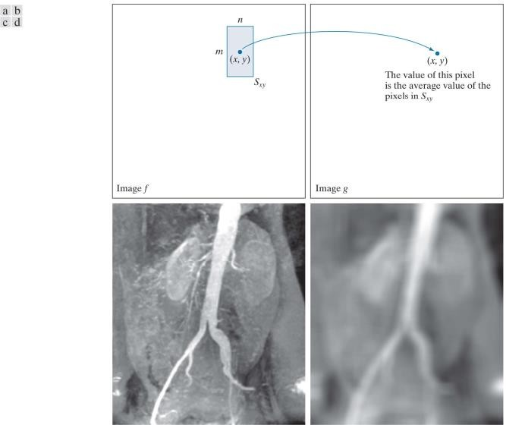
Spatial Operations
Neighborhood Operations
- The net effect is to perform local blurring in the original image.
Figure 6: Local averaging using neighborhood processing. The procedure is illustrated in (a) and (b) for a rectangular neighborhood. (c) An aortic angiogram (d) The result of using neighborhood operations.

Slide 31
Spatial Operations
Neighborhood operations
At first we need to select the center pixel and find it’s 3x3 neighbors and calculate the average of all neighbor pixels and update the center pixel.
7 | 5 | 2 | 7 | 2 | 1 | 5
1 | 5 | 2 | 9 | 2 | 8 | 8
7 | 4 | 1 | 8 | 1 | 4 | 5
6 | 4 | 2 | 7 | 2 | 2 | 5
6 | 5 | 2 | 4 | 2 | 1 | 5
5 | 5 | 2 | 5 | 2 | 8 | 4
5 | 4 | 2 | 2 | 2 | 5 | 5
5 | 4 | 3 | 4 | 3 | 6 | 2

Slide 32
Spatial Operations
Neighborhood operations
At first we need to select the border pixel as the center pixel and to find it’s 3x3 neighbors, zero padding is needed and calculate the average of all neighbor pixels and update the center pixel.
0 | 0 | 0 | 0 | 0 | 0 | 0 | 0 | 0
0 | 7 | 5 | 2 | 7 | 2 | 1 | 5 | 0
0 | 1 | 5 | 2 | 9 | 2 | 8 | 8 | 0
0 | 7 | 4 | 1 | 8 | 1 | 4 | 5 | 0
0 | 6 | 4 | 2 | 7 | 2 | 2 | 5 | 0
0 | 6 | 5 | 2 | 4 | 2 | 1 | 5 | 0
0 | 5 | 5 | 2 | 5 | 2 | 8 | 4 | 0
0 | 5 | 4 | 2 | 2 | 2 | 5 | 5 | 0
0 | 5 | 4 | 3 | 4 | 3 | 6 | 2 | 0
0 | 0 | 0 | 0 | 0 | 0 | 0 | 0 | 0

Slide 33
Spatial Operations
Geometric spatial transformations
-Spatial transformation of an image is a geometric transformation of the image coordinate system.
(v, w) = T{(x, y)}
Where,
(x, y) - pixel coordinates in the original image
(v, w) -The corresponding pixel coordinates in the transformed image

Slide 34
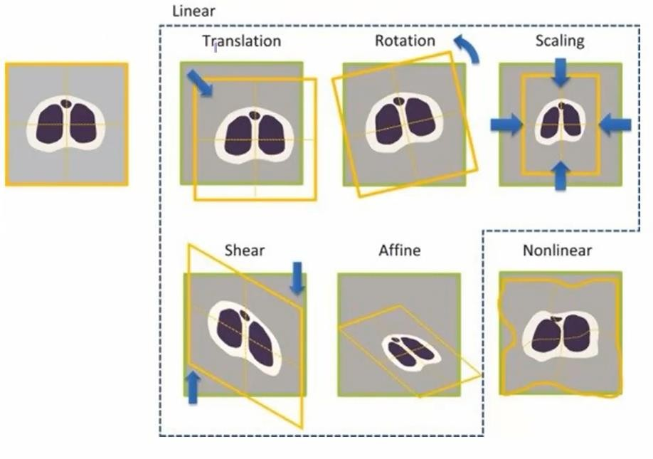
Spatial Operations
Geometric spatial transformations

Slide 35
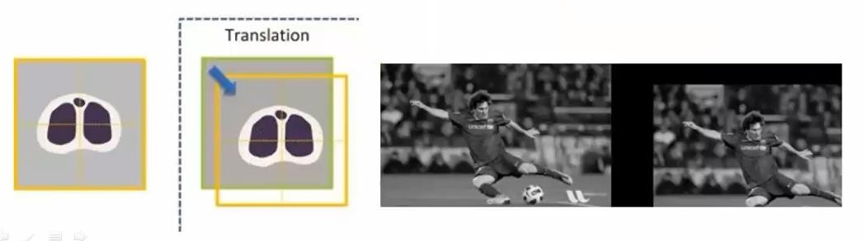
Spatial Operations
Geometric Spatial Operations (Translation)
It is known as shifting of object’s location.
Here, (x, y)=(0,0)
𝑡_{𝑥}, 𝑡_{𝑦} = (15, 13)
Here,
1 0 𝑡_{𝑥}
𝑀 = 0 1 𝑡_{𝑦}
0 0 1
𝑢
1 0 𝑡_{𝑥}
1 𝑡_{𝑦} ∗
0 0 1
𝑥
𝑦
1
[_{𝑣}]= 0

Slide 36
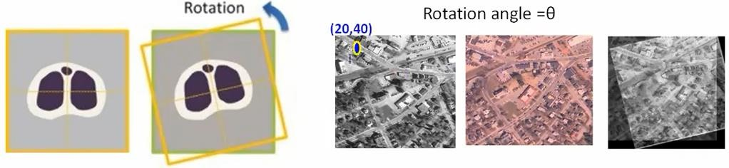
Spatial Operations
Geometric spatial transformations (Rotation)
It rotates an image by a specified angle.
Here,
𝑢
𝑣
𝑐𝑜𝑠𝜃
𝑠𝑖𝑛𝜃 0
−𝑠𝑖𝑛𝜃 0
𝑐𝑜𝑠𝜃 0
0 1
𝑥
𝑦 1
-
=
∗
- (x, y)=(20, 40)

Slide 37
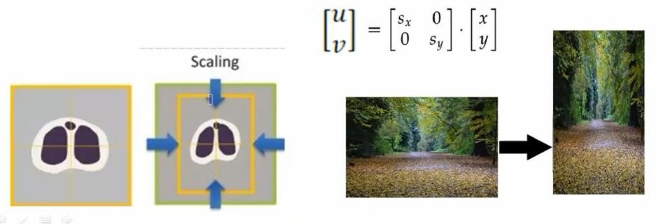
Spatial Operations
Geometric spatial transformations (Scaling)
Scaling means resize of an image in terms of scaling factor.
If we have an image of (300 X 400) and we want to transform it into a shape of (600 X 200).
The scaling in X and Y direction will be 600/300=2 and 200/400 =1/2

Slide 38
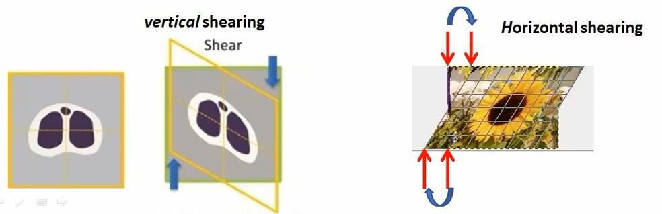
Spatial Operations
Geometric spatial transformations (Shearing)
Shearing an image means shifting the pixel values either horizontally or vertically.
Basically, this shifts some part of an image to one direction and other parts to the another direction. Horizontal shearing will shift the upper part to the right and lower part to the left. Vertical shearing will shift left part to upper and right part to lower.

Slide 39
Thank You ☺

